Slide 1
UNSUPERVISED LEARNING
PCA

Slide 2
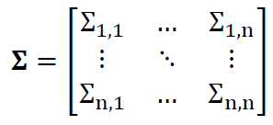
Curse of dimensionality
If the number of features ‘n’ is large, the number of samples m, may be too small for accurate parameter estimation
covariance matrix has n^2 parameters
For accurate estimation, sample size should be much bigger than n^2,to be able to accurately represent the covariance, otherwise the model may become too complicated for the data, overfitting
If m < n^2 we assume that features are uncorrelated (because we cannot represent it accurately with the given m points), even if we know this assumption is wrong. Doing so, we do not represent the covariance as parameters in our model

Slide 3
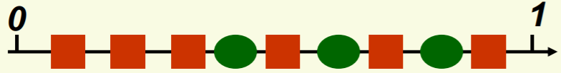
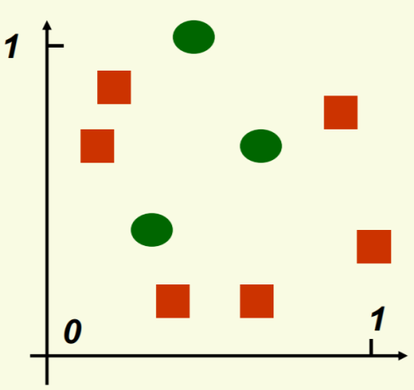
Curse of dimensionality
Suppose we have nine data points on a single dimension as shown
The feature is no very discriminative i.e. does not help in segregating these points clearly
Then we represent these data points in two dimensions…

Slide 4
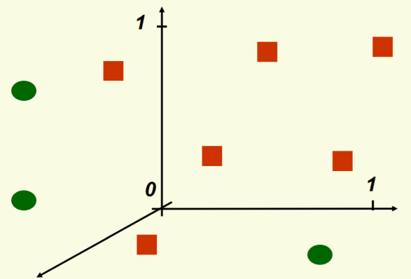
Curse of dimensionality
Yet again the two features are not helping in cleanly separating the data points. So we add another feature, a third dimension
The data points get spread far and wide. The problem with this state is, we do not now how the data would have been spread (if we had more) in these empty spaces
These points are samples with certain distribution. If we take a fresh set of same m data points and plot them in against these attributes, they may be at different locations!
The model surfaces that are created in these situations, are likely to overfit (cleanly separate the classes) and prone to variance errors i.e. fail to perform on new sample and also in production

Slide 5
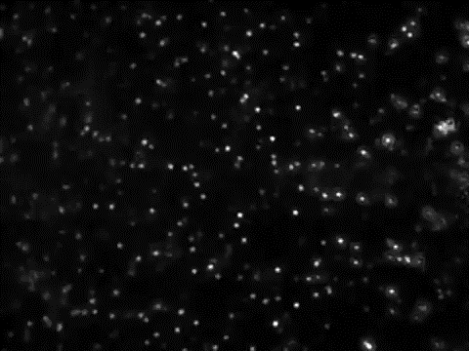
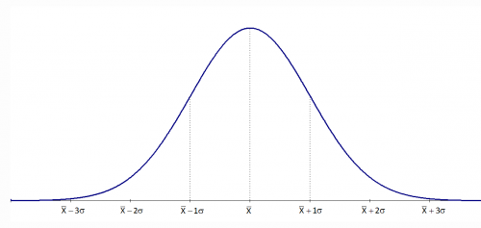



Modelling Errors – Variance error
Universe / Population
Time T1
Time T2
Sample / snapshot

Slide 6
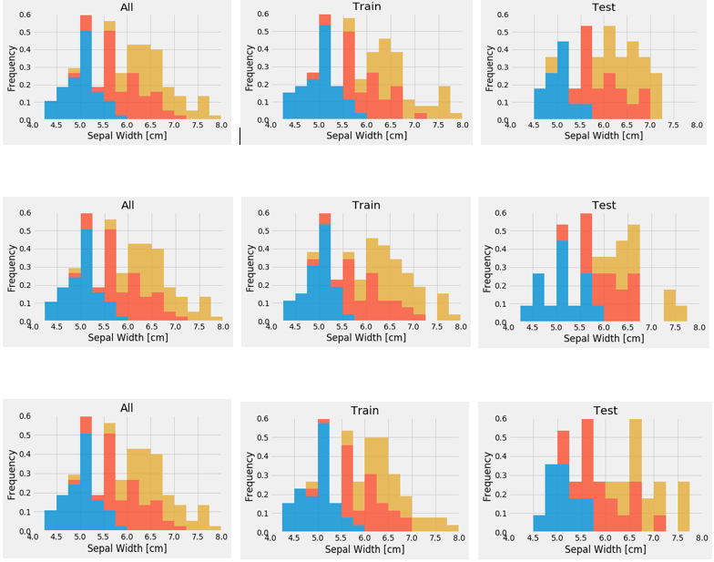
Modelling Errors Visual demo of variance in training and test data
Sample Data (Analytics Base Table)
Three Random Training Sets From ABT
Three Random Test Sets From ABT

Slide 7
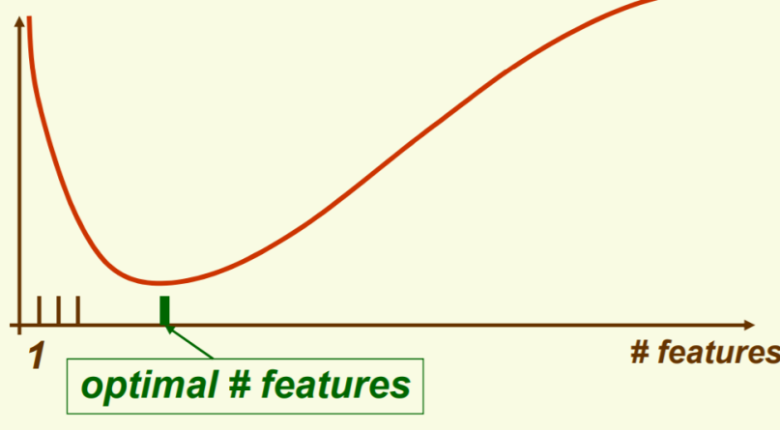
Curse of dimensionality
In general, if n samples is dense enough in 1D
Then in d dimensions we need n^d samples and n^d grows as a function of d
For a given sample size, If we can’t solve a problem with a few features, adding more features seems like a good idea
As we add more features, the data points get scattered far and wide (sparse feature space)
Any model in such a case is likely to be overfit and exposed to variance errors. This is curse of dimensionality and very common in applications such as image processing

Slide 8
Dimensionality Reduction
Dimensionality reduction is the process of eliminating features to reduce the sparsity of the feature space without impacting the total information content
It involves employing co-variance filters, low variance filters to drop attributes that do not significantly contribute to the total information in the model
Instead of dropping correlated dimension, we can also engineer a new composite dimension to represent the original two and replace them with the new dimension. This is done through Principal Component Analysis (PCA)
Another method called Fischer Linear Discriminant Analysis (LDA, not in scope) also does same. Ref: https://en.wikipedia.org/wiki/Linear_discriminant_analysis

Slide 9
Principal Component Analysis Concepts

Slide 10
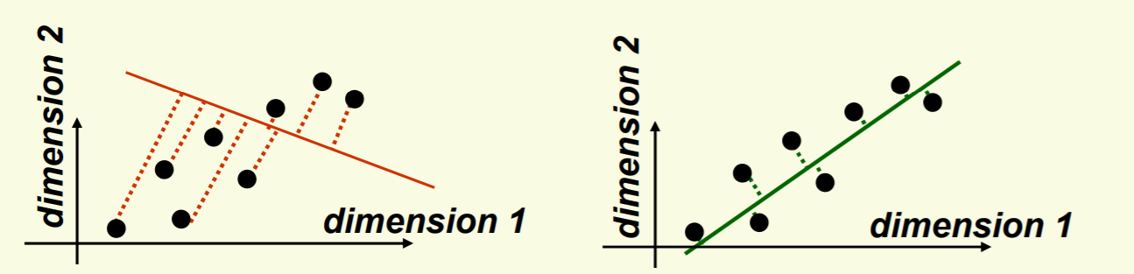
Principal Component Analysis
Main idea: seek most accurate data representation in a lower dimensional space
Example in 2-D, project data to 1-D subspace (a line) with minimal projection error
In both the pictures above, the data points (black dots) are projected to one line but the second line is closer to the actual points (less projection errors) than first one
Notice that the good line to use for projection lies in the direction of largest variance

Slide 11
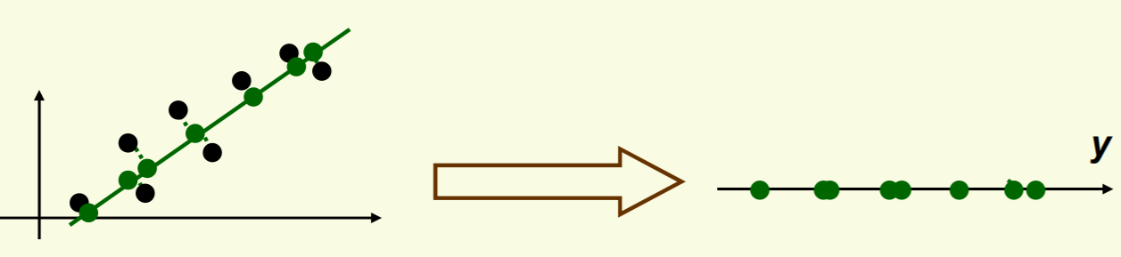
Principal Component Analysis
Main idea: seek most accurate data representation in a lower dimensional space
Example in 2-D, project data to 1-D subspace (a line) with minimal projection error
After the data is projected on the best line, need to transform the coordinate system to get 1D representation for vector y
Note that new data y has the same variance as old data x in the direction of the green line
PCA preserves largest variances in the data
Ref: http://www.cs.haifa.ac.il/~rita/uml_course/add_mat/PCA.pdf

Slide 12
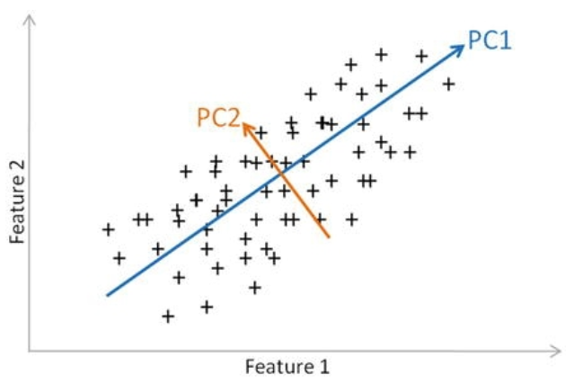
Principal Component Analysis
In general PCA on n dimensions will result in another set of new n dimensions. The one which captures maximum variance in the underlying data is the principal component 1, principal component 2 is orthogonal to it
Example in 2-D, project data to 1-D subspace (a line) with minimal projection error
Ref: http://www.cs.haifa.ac.il/~rita/uml_course/add_mat/PCA.pdf

Slide 13
Mechanics of Principal Component Analysis

Slide 14
Principal Component Analysis steps
Begins by standardizing the data. Data on all the dimensions are subtracted from their means to shift the data points to the origin. i.e. the data is centered on the origins
Generate the covariance matrix / correlation matrix for all the dimensions
Perform eigen decomposition, that is, compute eigen vectors which are the principal components and the corresponding eigen values which are the magnitudes of variance captured
Sort the eigen pairs in descending order of eigen values and select he one with the largest value. This is the first principal component that covers the maximum information from the original data
Ref: http://www.cs.haifa.ac.il/~rita/uml_course/add_mat/PCA.pdf

Slide 15
PCA
The Algebraic Operations

Slide 16
PART – I
What is Principal Component Analysis
Concept of Noise and Signal and SNR
Variance, Covariance and Covariance matrix
Objective of increasing Signal over noise
Axis rotation and stretch to increase signal and reduce noise

Slide 17
Principal Component Analysis - Repeat
Principal Component Analysis attempts to hit two birds with same stone –
It transform existing dimensions to increase the SNR. It creates a new dimension out of the original two
Helps Remove redundancy by eliminating attributes /dimensions which contain same information as another attribute.

Slide 18
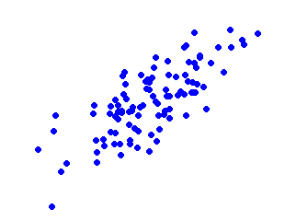
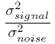
Principal Component Analysis (Signal to noise ratio)
Noise
Signal – all valid values for a variable (show between max and min values for x axis and y axis). Represents a valid data
Noise – The spread of data points across the best fit line. For a given value of x, there are multiple values of y (some on line and some around the line). This spread is due to random factors
Signal to Noise Ratio – Variance of signal / variance in noise.
Greater the SNR the better the model will be
Y max
Y min
X min
X max
Signal
X_std_df = pd.DataFrame(X_std)
axes = pd.plotting.scatter_matrix(X_std_df)
plt.tight_layout()

Slide 19
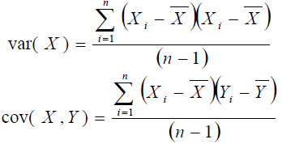
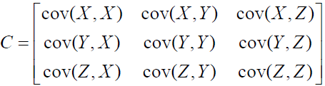
Principal Component Covariance Matrix
Variance is measured within the dimensions and co-variance is among the dimensions
Express total variance (variance and cross variance between dimensions as a matrix (variance matrix)
Covariance matrix is a mathematical representation of the total variance of individual dimension and across dimensions .
Covariance matrix for three dimensions x,y and z
eig_vals, eig_vecs = np.linalg.eig(cov_matrix)

Slide 20
Improving SNR through PCA ( Scaling the dimensions)
The mean is subtracted from all the points on both dimensions i.e. (xi – xbar) and (yi – ybar)
The dimensions are transformed using algebra into new set of dimensions
The transformation is a rotation of axes in mathematical space
2nd Principal Component
1 st Principal Component
X_std = StandardScaler().fit_transform(X)
eig_vals, eig_vecs = np.linalg.eig(cov_matrix)

Slide 21
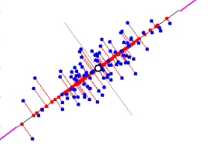
Improving SNR through PCA (Principal components)
The original data points are now represented by the red dots on new dimensions
It also introduces error of representation (vertical red lines from the blue dots to corresponding red dots on the new dimension)
The axis rotation is done such that the new dimension captures max variance in the data points and also reduces total error of representation
Noise
X min
X max
Signal
print('Eigen Vectors \n%s', eig_vecs)
print('\n Eigen Values \n%s', eig_vals)

Slide 22

Improving SNR through PCA (Principal components)
The first principal component is thus a new dimension representing the two original dimensions. We do away with the original two dimensions

Slide 23
PART - 2
Each record in mathematical space is a data point
Data points in mathematical space as vectors
Transpose a matrix for cross dimensional analysis
Covariance as a product of matrix multiplication with its transpose

Slide 24

PCA (Data points are vectors in feature space)
Each data point in mathematical space can be represented as a vector on the dimensions with certain magnitude on each dimension
Thus, a vector can be represented as single dimension matrix (for e.g. X below)
y value
X
y
Data point as a vector
X
x value

Slide 25
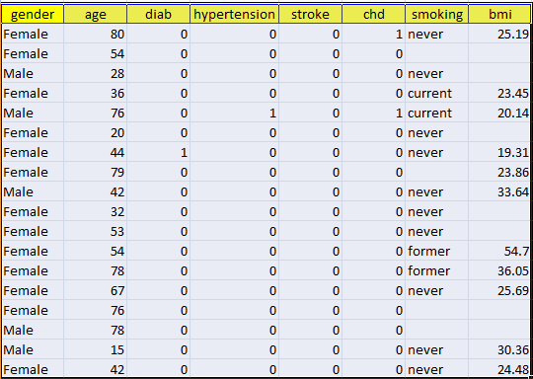
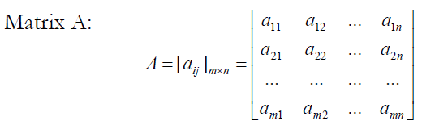
PCA (Data frame as 2D matrix)
n Data points (represented as m dimensional vectors)
Original data
m dimensions
An element of matrix

Slide 26
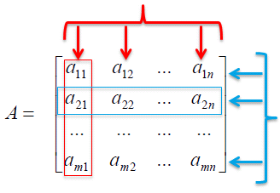
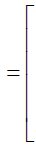
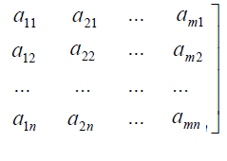
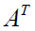
PCA (Data frame as 2D matrix and it’s transformation)
The matrix A when transposed i.e. The rows become columns and vice versa, reflects every row as one record
Data points
dimensions
Data points
dimensions

Slide 27

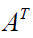
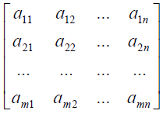



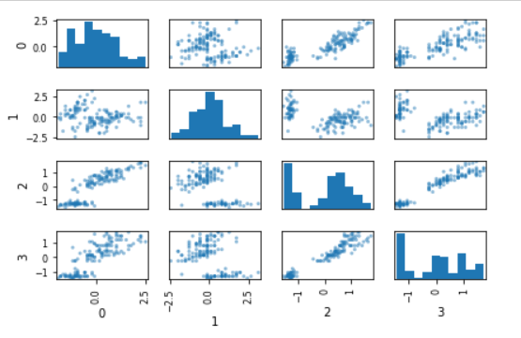
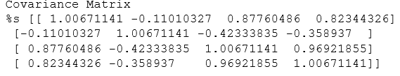
PCA (Calculating total variance (covariance and variance )
Multiplying the two matrices produces a matrix of total variance also called covariance matrix (a square and symmetric matrix).

Slide 28
PART – 3
Principal Component Properties
Covariance matrix between principal components
Covariance matrix for principal components is a diagonal matrix
Transform original set of vectors to new set of vectors whose covariance matrix is diagonal

Slide 29
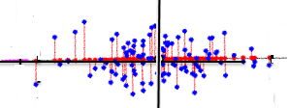
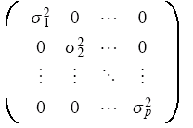
Properties of principal components and their covariance matrix
The principal component dimensions will be orthogonal to one another.
The first one will cover maximum variance in the raw dimension
The second one will be perpendicular to the first one.
Since there are no dependencies, the data points will be spread around the second component
Thus the covariance matrix for the two principal components will have the off diagonal values as zero or close to zero (such matrix is called diagonal matrix)
2
1

Slide 30


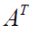
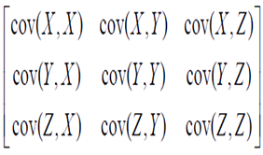
Properties of principal components and their covariance matrix
Thus to find principal components we need to get the diagonal matrix from the original covariance matrix
For this we have to transform the matrix A to a new matrix B such that the covariance matrix of B ( ), is a diagonal matrix (Ref to part 2, bullet 5)

Slide 31
PART – 4
Matrix transformation
Covariance matrix between principal components
Covariance matrix for principal components is a diagonal matrix
Transform original set of vectors to new set of vectors whose covariance matrix is diagonal

Slide 32
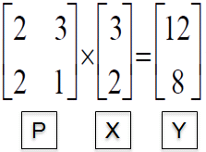
Matrix Algebra for PCA
Let X be a m X n dimensional matrix or a set of vectors
It can be transformed into another matrix Y of m X n dimensions using P (another matrix of n X m dimensions)
The matrix P could represent some weights for each dimension each row of X
For e.g. – P transforms X into Y. This transformation is usually a rotation and a stretch (Ref to slide 5 part 1)

Slide 33

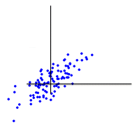
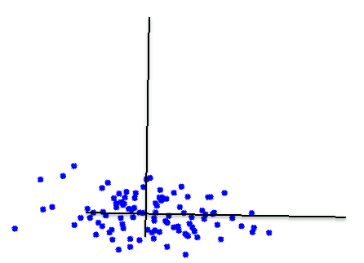
Matrix Transformations
Our goal is to transform X using P such that PX = Y and the covariance matrix is a diagonal matrix (values off diagonal are zero)
Remember, we are moving from view 1 to view 2 of the mathematical space (as per the animation)
Which means the transformation matrix P must represent the new dimensions into which all points are first projected to maximize SNR. Second stage of the animation...
X (after subtracting mean )
Y
P

Slide 34
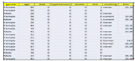
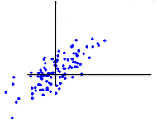
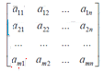
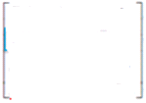
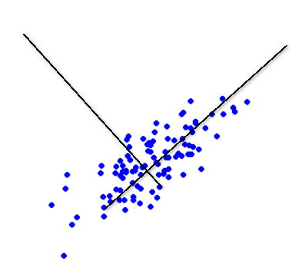
X
Y
P
X

Slide 35
PART - 5
Eigen vectors and Eigen Values
Matrix as product of Eigen Vectors and Diagonal matrix
What Diagonal matrix represents
Core Mathematical stuff

Slide 36
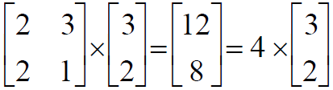
Matrix Algebra for PCA
We can recreate original matrix x from y and express y as some scalar multiple of original matrix.
Thus P transforms the vector x in to vector y which is nothing but vector x extended 4 times without changing the direction (in this example)
This property of matrix transformation where PX = K (X) is eigen vector decomposition. X is called eigen vector of P and K is eigen value of P
P
X
Y
X

Slide 37
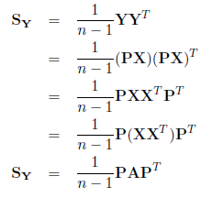

Sy is covariance matrix of the transformed matrix Y
Y = P X where X is original matrix
A is covariance matrix of X
Any matrix A can be represented as a product of a diagonal matrix D and corresponding eigen vector E and E transpose
The trick is to select P such that when multiplied with D and P transpose , it gives A i.e. P = E

Slide 38
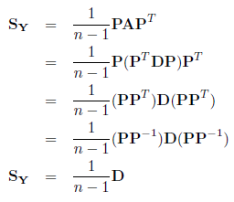
Thus Sy can now be shown as -→
Replace A with product of P transpose , diagonal matrix and P
P multiplied by P transpose is same as P multiplied by P inverse = 1
The reason why we insist on representing covariance matrix A as diagonal matrix is that in diagonal matrix the off diagonal variance is 0 and ...
P represents new basis vectors or dimensions which when used to represent data points result in covariance 0
Each element of Sy is variance of X along corresponding new basis vector in P
http://stats.stackexchange.com/questions/2691/making-sense-of-principal-component-analysis-eigenvectors-eigenvalues
http://www.thejuliagroup.com/blog/?p=4777

Slide 39
THANK YOU

